Slide 1
Lab 4 - K-means++ and Hierarchical Clustering
CS 506

Slide 2
Do not edit How to change the design
Is the following a possible output of K-means++ clustering?
The Slido app must be installed on every computer you’re presenting from

Slide 3
Recall: K-means++
K-means++ utilizes a different centroid initialization technique. Otherwise, it is the same as K-means!

Slide 4
K-means++ utilizes a different centroid initialization technique. Otherwise, it is the same as K-means!
Start with a random centroid

Slide 5

K-means++ utilizes a different centroid initialization technique. Otherwise, it is the same as K-means!
Start with a random centroid
Let $D\left(x\right)$ be the distance between point $x$ and the closest of the centers picked so far. Choose next center with probability proportional to $D{\left(x\right)}^{2}$

Slide 6
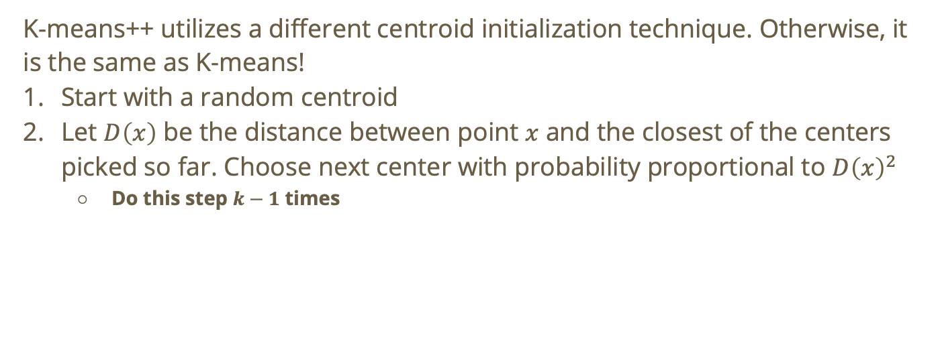
K-means++ utilizes a different centroid initialization technique. Otherwise, it is the same as K-means!
Start with a random centroid
Let $D\left(x\right)$ be the distance between point $x$ and the closest of the centers picked so far. Choose next center with probability proportional to $D{\left(x\right)}^{2}$
Do this step $k−1$ times

Slide 7
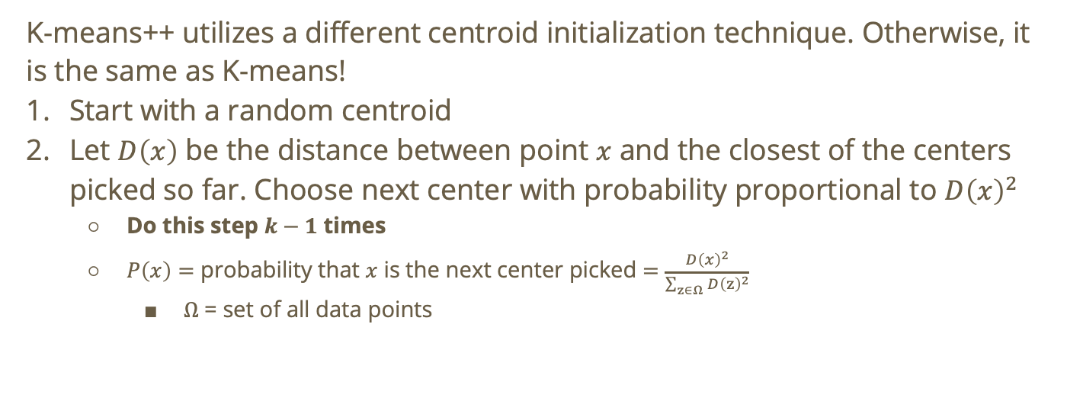
K-means++ utilizes a different centroid initialization technique. Otherwise, it is the same as K-means!
Start with a random centroid
Let $D\left(x\right)$ be the distance between point $x$ and the closest of the centers picked so far. Choose next center with probability proportional to $D{\left(x\right)}^{2}$
Do this step $k−1$ times
$P\left(x\right)=$ probability that $x$ is the next center picked $=\frac{D{\left(x\right)}^{2}}{\sum_{z∈Ω}{D{\left(z\right)}^{2}}}$
$Ω$ = set of all data points

Slide 8
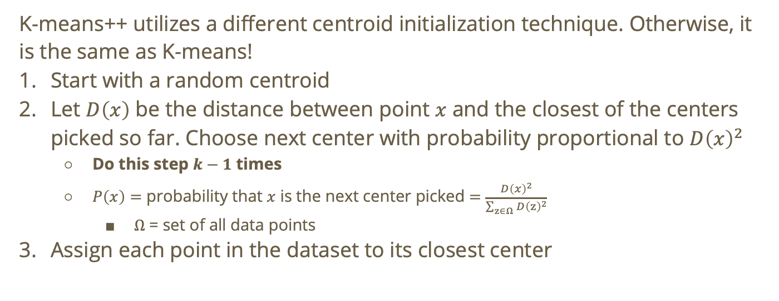
K-means++ utilizes a different centroid initialization technique. Otherwise, it is the same as K-means!
Start with a random centroid
Let $D\left(x\right)$ be the distance between point $x$ and the closest of the centers picked so far. Choose next center with probability proportional to $D{\left(x\right)}^{2}$
Do this step $k−1$ times
$P\left(x\right)=$ probability that $x$ is the next center picked $=\frac{D{\left(x\right)}^{2}}{\sum_{z∈Ω}{D{\left(z\right)}^{2}}}$
$Ω$ = set of all data points
Assign each point in the dataset to its closest center

Slide 9
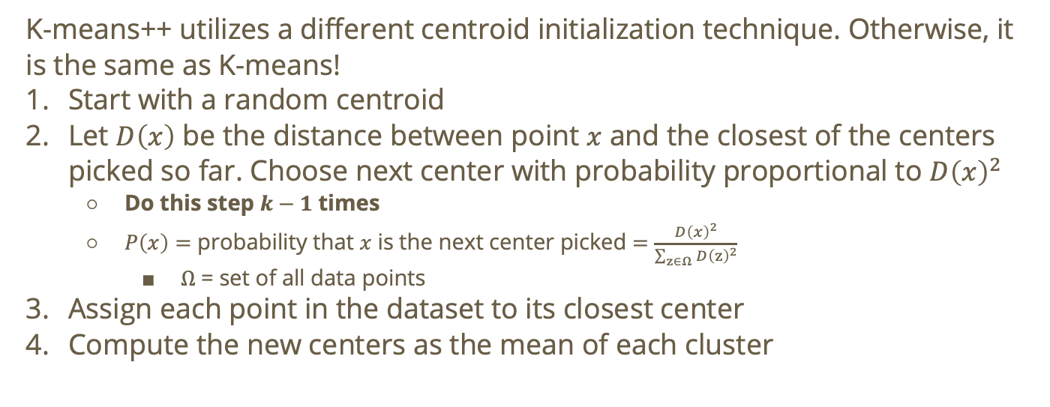
K-means++ utilizes a different centroid initialization technique. Otherwise, it is the same as K-means!
Start with a random centroid
Let $D\left(x\right)$ be the distance between point $x$ and the closest of the centers picked so far. Choose next center with probability proportional to $D{\left(x\right)}^{2}$
Do this step $k−1$ times
$P\left(x\right)=$ probability that $x$ is the next center picked $=\frac{D{\left(x\right)}^{2}}{\sum_{z∈Ω}{D{\left(z\right)}^{2}}}$
$Ω$ = set of all data points
Assign each point in the dataset to its closest center
Compute the new centers as the mean of each cluster

Slide 10
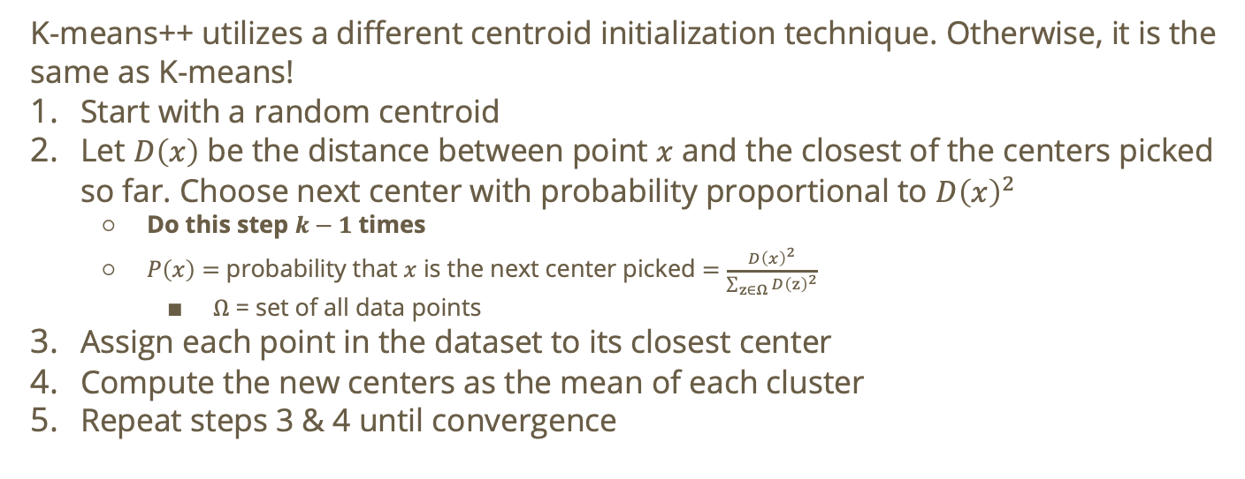
K-means++ utilizes a different centroid initialization technique. Otherwise, it is the same as K-means!
Start with a random centroid
Let $D\left(x\right)$ be the distance between point $x$ and the closest of the centers picked so far. Choose next center with probability proportional to $D{\left(x\right)}^{2}$
Do this step $k−1$ times
$P\left(x\right)=$ probability that $x$ is the next center picked $=\frac{D{\left(x\right)}^{2}}{\sum_{z∈Ω}{D{\left(z\right)}^{2}}}$
$Ω$ = set of all data points
Assign each point in the dataset to its closest center
Compute the new centers as the mean of each cluster
Repeat steps 3 & 4 until convergence

Slide 11
K-means++ utilizes a different centroid initialization technique. Otherwise, it is the same as K-means!
Start with a random centroid
Let $D\left(x\right)$ be the distance between point $x$ and the closest of the centers picked so far. Choose next center with probability proportional to $D{\left(x\right)}^{2}$
Do this step $k−1$ times
$P\left(x\right)=$ probability that $x$ is the next center picked $=\frac{D{\left(x\right)}^{2}}{\sum_{z∈Ω}{D{\left(z\right)}^{2}}}$
$Ω$ = set of all data points
Assign each point in the dataset to its closest center
Compute the new centers as the mean of each cluster
Repeat steps 3 & 4 until convergence
This is just K-means! (without the ++)

Slide 12
Do not edit How to change the design
To find the optimal number of clusters in K-means, we run K-means multiple times for different values of k then we pick the the one with the lowest cost
The Slido app must be installed on every computer you’re presenting from

Slide 13
What would the lowest cost be?

Slide 14

What would the lowest cost be?
The lowest cost will occur when $k = N$. We can show this using the k-means cost function

Slide 15
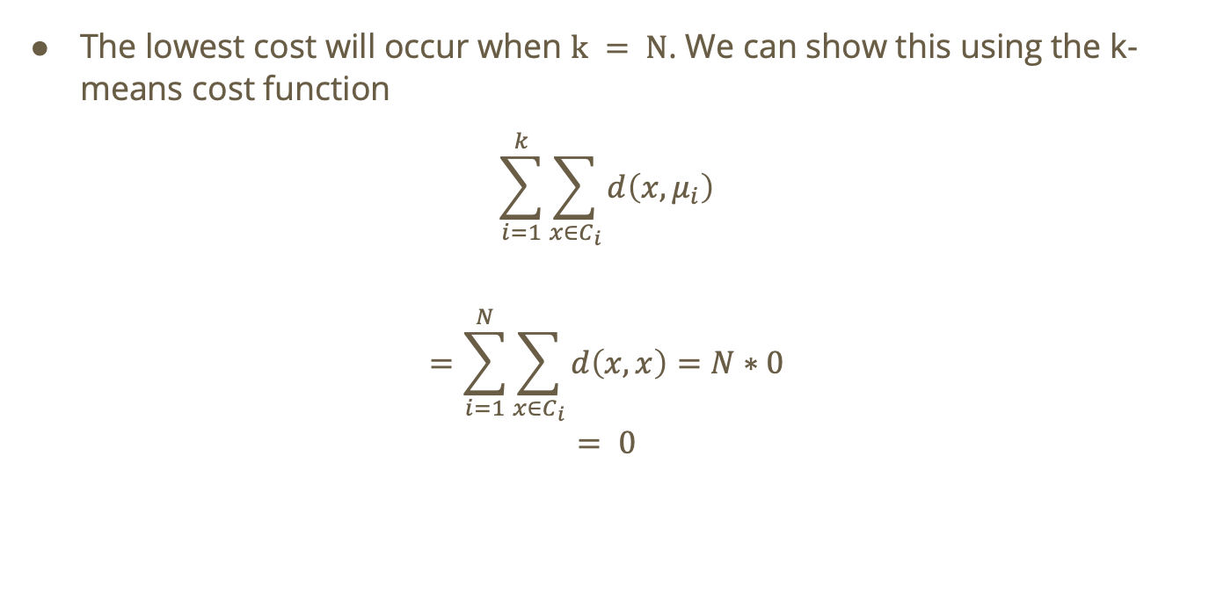
The lowest cost will occur when $k = N$. We can show this using the k-means cost function
$$\sum_{i=1}^{k}{\sum_{x∈C_{i}}{d\left(x,μ_{i}\right)}}$$
$$=\sum_{i=1}^{N}{\sum_{x∈C_{i}}{d\left(x,x\right)}}=N∗0$$
$$= 0$$

Slide 16
Is this trivial?

Slide 17

Is this trivial?
If $k = N$ then every point has its own cluster

Slide 18

Is this trivial?
If $k = N$ then every point has its own cluster
How are we supposed to detect trends in our data if we aren’t even grouping data together?

Slide 19
Is this trivial?
YES

Slide 20
Recall: methods for finding the optimal k
Iterate over different k’s and find the point of diminishing returns for cost vs. k

Slide 21
Recall: methods for finding the optimal k
Iterate over different k’s and find the point of diminishing returns for cost vs. k
Use empirical/domain-specific knowledge

Slide 22
Recall: methods for finding the optimal k
Iterate over different k’s and find the point of diminishing returns for cost vs. k
Use empirical/domain-specific knowledge
Metric for evaluating a cluster output

Slide 23
Recall: methods for finding the optimal k
Iterate over different k’s and find the point of diminishing returns for cost vs. k
Use empirical/domain-specific knowledge
Metric for evaluating a cluster output
E.g., silhouette scores!

Slide 24

Recall: silhouette scores!
For each data point $i$:
$a_{i}$ = mean distance from $i$ to every other point in its cluster
$b_{i}$ = smallest mean distance from $i$ to every point in another cluster

Slide 25
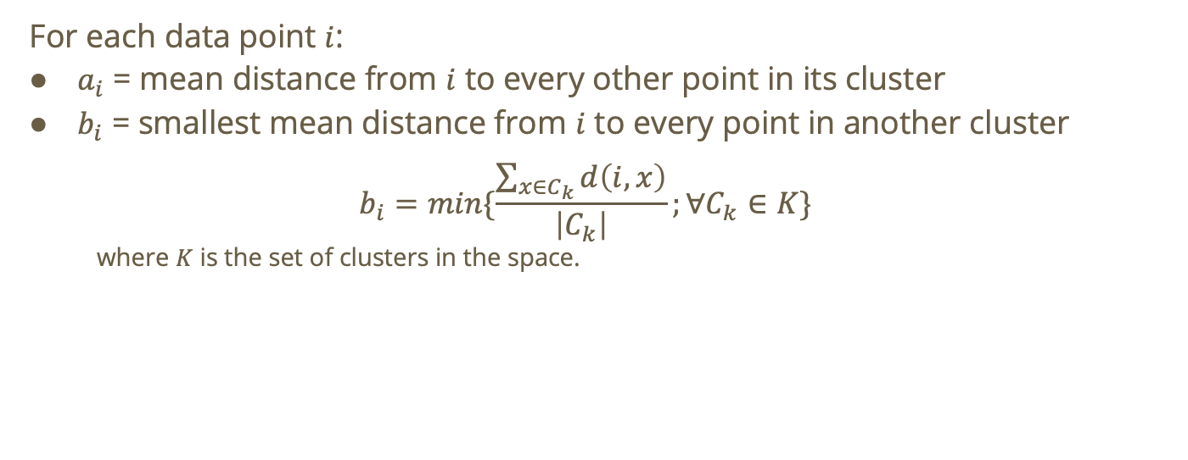
For each data point $i$:
$a_{i}$ = mean distance from $i$ to every other point in its cluster
$b_{i}$ = smallest mean distance from $i$ to every point in another cluster
$$b_{i}=min\{\frac{\sum_{x∈C_{k}}{d\left(i,x\right)}}{\left|C_{k}\right|};∀C_{k}∈K\}$$
where $K$ is the set of clusters in the space.

Slide 26
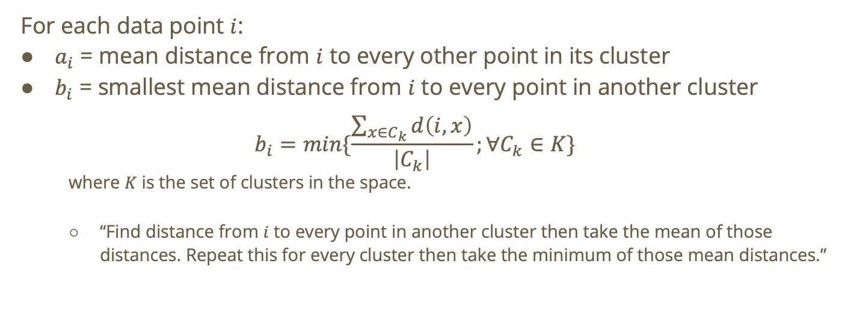
For each data point $i$:
$a_{i}$ = mean distance from $i$ to every other point in its cluster
$b_{i}$ = smallest mean distance from $i$ to every point in another cluster
$$b_{i}=min\{\frac{\sum_{x∈C_{k}}{d\left(i,x\right)}}{\left|C_{k}\right|};∀C_{k}∈K\}$$
where $K$ is the set of clusters in the space.
“Find distance from $i$ to every point in another cluster then take the mean of those distances. Repeat this for every cluster then take the minimum of those mean distances.”

Slide 27
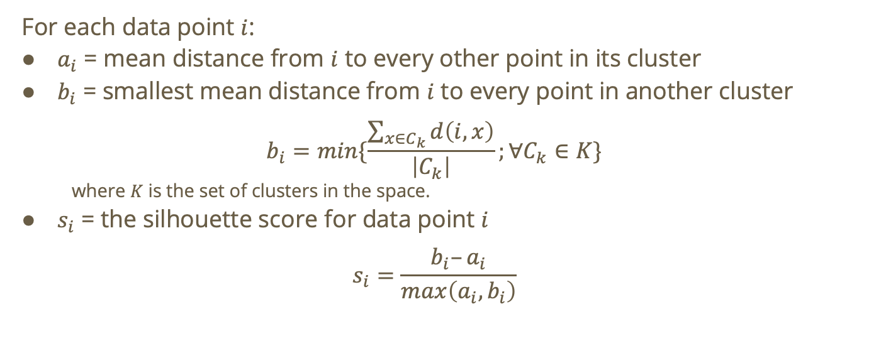
For each data point $i$:
$a_{i}$ = mean distance from $i$ to every other point in its cluster
$b_{i}$ = smallest mean distance from $i$ to every point in another cluster
$$b_{i}=min\{\frac{\sum_{x∈C_{k}}{d\left(i,x\right)}}{\left|C_{k}\right|};∀C_{k}∈K\}$$
where $K$ is the set of clusters in the space.
$s_{i}$ = the silhouette score for data point $i$
$$s_{i}=\frac{b_{i}–a_{i}}{max\left(a_{i},b_{i}\right)}$$

Slide 28

How to interpret the silhouette score?
$$s_{i}=\frac{b_{i}–a_{i}}{max\left(a_{i},b_{i}\right)}$$
The silhouette score tells us how well each point fits inside its cluster vs. how much it belongs to another cluster.

Slide 29
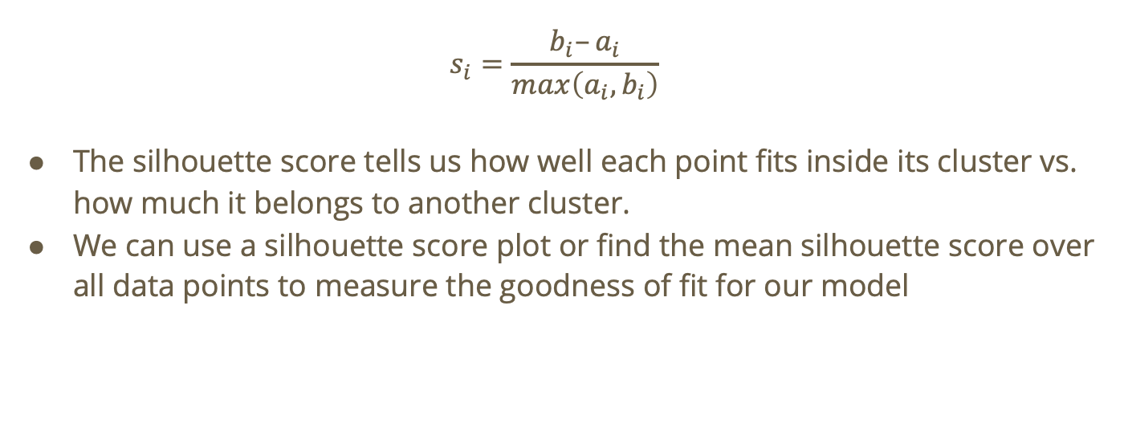
How to interpret the silhouette score?
$$s_{i}=\frac{b_{i}–a_{i}}{max\left(a_{i},b_{i}\right)}$$
The silhouette score tells us how well each point fits inside its cluster vs. how much it belongs to another cluster.
We can use a silhouette score plot or find the mean silhouette score over all data points to measure the goodness of fit for our model

Slide 30
Do not edit How to change the design
What does it mean if the silhouette score for a data point is close to 1?
The Slido app must be installed on every computer you’re presenting from

Slide 31

Interpreting silhouette scores
When will $s_{i} →1$?

Slide 32

Interpreting silhouette scores
When will $s_{i} →1$?
$$\lim_{a_{i}→0}\frac{b_{i}–a_{i}}{max\left(a_{i},b_{i}\right)} = ?$$

Slide 33

Interpreting silhouette scores
When will $s_{i} →1$?
$$\lim_{a_{i}→0}\frac{b_{i}–a_{i}}{max\left(a_{i},b_{i}\right)} = 1$$

Slide 34

Interpreting silhouette scores
When will $s_{i} →1$?
$$\lim_{a_{i}→0}\frac{b_{i}–a_{i}}{max\left(a_{i},b_{i}\right)} = 1$$
When will $s_{i}→0$?

Slide 35

Interpreting silhouette scores
When will $s_{i} →1$?
$$\lim_{a_{i}→0}\frac{b_{i}–a_{i}}{max\left(a_{i},b_{i}\right)} = 1$$
When will $s_{i}→0$? When $b_{i}≈a_{i}$

Slide 36

Interpreting silhouette scores
When will $s_{i} →1$?
$$\lim_{a_{i}→0}\frac{b_{i}–a_{i}}{max\left(a_{i},b_{i}\right)} = 1$$
When will $s_{i}→0$? When $b_{i}≈a_{i}$
When will $s_{i}→−1?$
$$\lim_{b_{i}→?}\frac{b_{i}–a_{i}}{max\left(a_{i},b_{i}\right)}=−1$$

Slide 37

Interpreting silhouette scores
When will $s_{i} →1$?
$$\lim_{a_{i}→0}\frac{b_{i}–a_{i}}{max\left(a_{i},b_{i}\right)} = 1$$
When will $s_{i}→0$? When $b_{i}≈a_{i}$
When will $s_{i}→−1?$
$$\lim_{b_{i}→0}\frac{b_{i}–a_{i}}{max\left(a_{i},b_{i}\right)}=−1$$

Slide 38
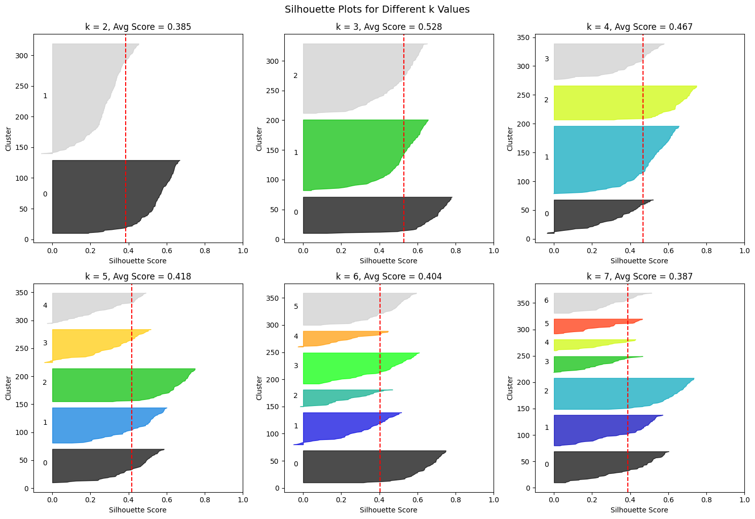
Silhouette Score Plots

Slide 39
Silhouette Score Plots: Interpretation

Slide 40
Each bin represents a cluster

Slide 41
Each bin represents a cluster
The Y-axis represents each data point, grouped by cluster

Slide 42
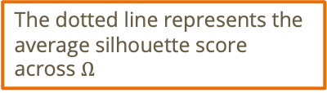
Each bin represents a cluster
The Y-axis represents each data point, grouped by cluster
The dotted line represents the average silhouette score across $Ω$

Slide 43



Do not edit How to change the design
How would you compare the clustering represented by the left plot versus the right plot? (select all that apply)
The Slido app must be installed on every computer you’re presenting from

Slide 44
Do not edit How to change the design
We TYPICALLY prefer clusterings with higher average silhouette scores and uniformly distributed silhouette scores across data points
The Slido app must be installed on every computer you’re presenting from

Slide 45
Do not edit How to change the design
What is the average silhouette score for a clustering with k=N?
The Slido app must be installed on every computer you’re presenting from

Slide 46
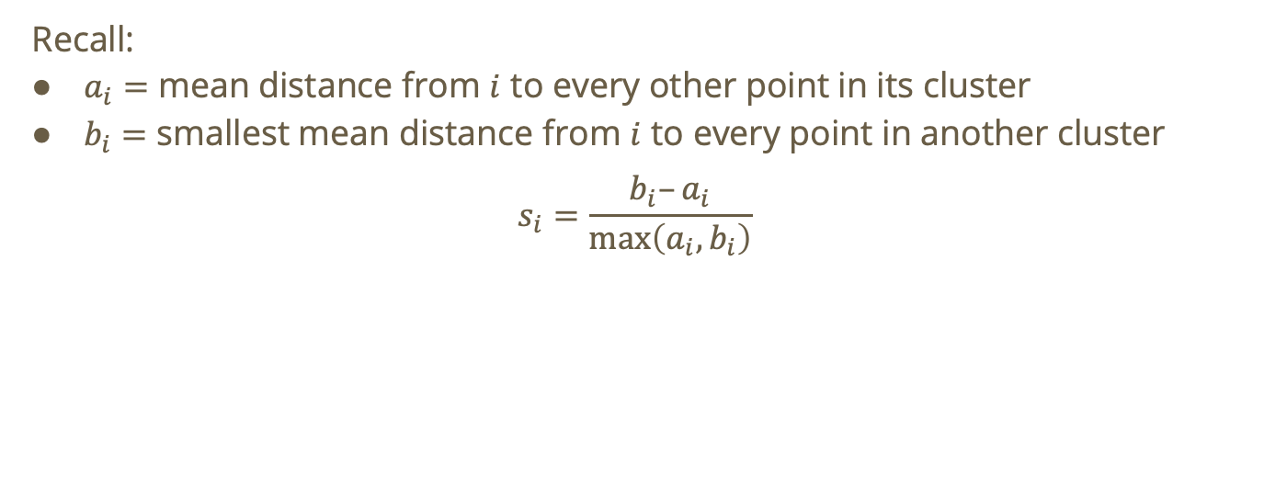
Solution
Recall:
$a_{i}=$ mean distance from $i$ to every other point in its cluster
$b_{i}=$ smallest mean distance from $i$ to every point in another cluster
$$s_{i}=\frac{b_{i}–a_{i}}{\max\left(a_{i},b_{i}\right)}$$

Slide 47
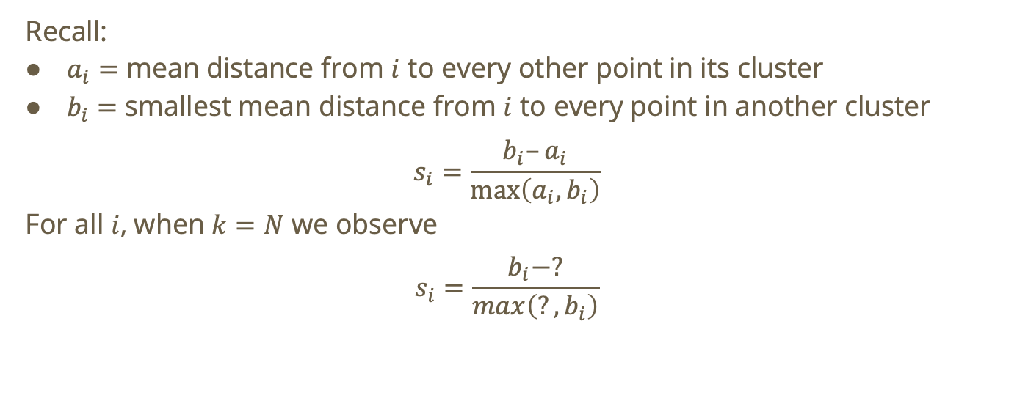
Solution
Recall:
$a_{i}=$ mean distance from $i$ to every other point in its cluster
$b_{i}=$ smallest mean distance from $i$ to every point in another cluster
$$s_{i}=\frac{b_{i}–a_{i}}{\max\left(a_{i},b_{i}\right)}$$
For all $i$, when $k=N$ we observe
$$s_{i}=\frac{b_{i}−?}{max\left(?,b_{i}\right)}$$

Slide 48
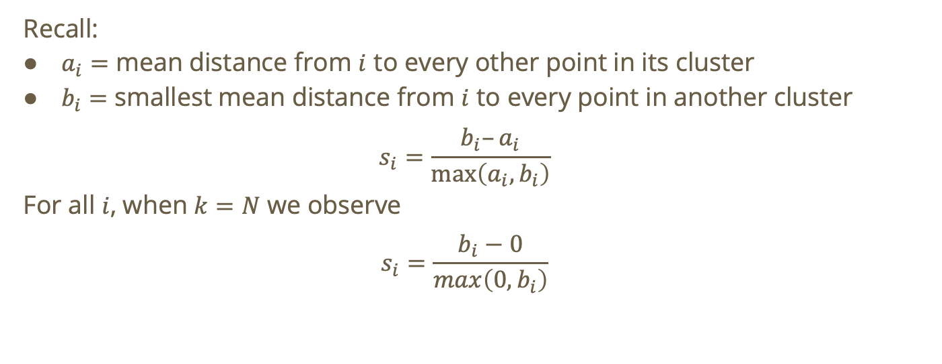
Solution
Recall:
$a_{i}=$ mean distance from $i$ to every other point in its cluster
$b_{i}=$ smallest mean distance from $i$ to every point in another cluster
$$s_{i}=\frac{b_{i}–a_{i}}{\max\left(a_{i},b_{i}\right)}$$
For all $i$, when $k=N$ we observe
$$s_{i}=\frac{b_{i}−0}{max\left(0,b_{i}\right)}$$

Slide 49
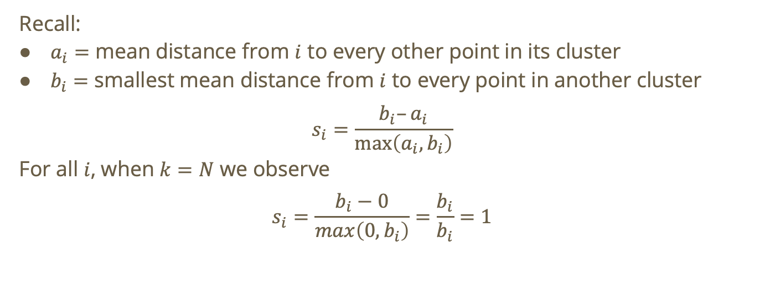
Solution
Recall:
$a_{i}=$ mean distance from $i$ to every other point in its cluster
$b_{i}=$ smallest mean distance from $i$ to every point in another cluster
$$s_{i}=\frac{b_{i}–a_{i}}{\max\left(a_{i},b_{i}\right)}$$
For all $i$, when $k=N$ we observe
$$s_{i}=\frac{b_{i}−0}{max\left(0,b_{i}\right)}=\frac{b_{i}}{b_{i}}=1$$

Slide 50
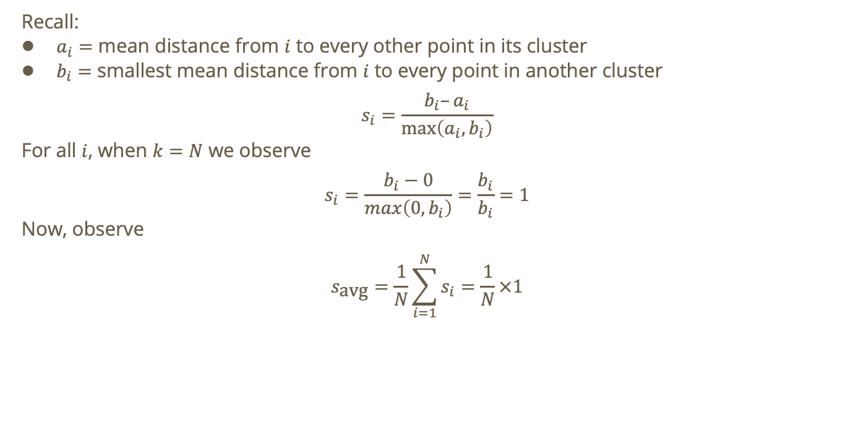
Solution
Recall:
$a_{i}=$ mean distance from $i$ to every other point in its cluster
$b_{i}=$ smallest mean distance from $i$ to every point in another cluster
$$s_{i}=\frac{b_{i}–a_{i}}{\max\left(a_{i},b_{i}\right)}$$
For all $i$, when $k=N$ we observe
$$s_{i}=\frac{b_{i}−0}{max\left(0,b_{i}\right)}=\frac{b_{i}}{b_{i}}=1$$
Now, observe
$$s_{\text{avg}}=\frac{1}{N}\sum_{i=1}^{N}{s_{i}}=\frac{1}{N}×1$$

Slide 51
Do not edit How to change the design
Let k = 2. Is K-means++ with a Euclidean distance-based cost function ideal for the following data?
The Slido app must be installed on every computer you’re presenting from

Slide 52
Do not edit How to change the design
See pictured.
The Slido app must be installed on every computer you’re presenting from

Slide 53
Why does K-means fail on the original dataset?

Slide 54
Why does K-means fail on the original dataset?
All clusters share the same center!

Slide 55
Why does K-means fail on the original dataset?
All clusters share the same center!
We don’t have linearly separable data in 2D → ?

Slide 56
Why does K-means fail on the original dataset?
All clusters share the same center!
We don’t have linearly separable data in 2D → minimizing cost function does not correspond to separating the concentric rings

Slide 57

Interpreting the transformation
$$z={\left(x−\overline{x}\right)}^{2}+{\left(y−\overline{y}\right)}^{2}$$

Slide 58
$$z={\left(x−\overline{x}\right)}^{2}+{\left(y−\overline{y}\right)}^{2}$$
We are transforming onto a 1D space!

Slide 59
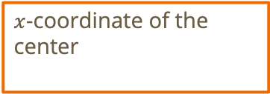
$$z={\left(x−\overline{x}\right)}^{2}+{\left(y−\overline{y}\right)}^{2}$$
We are transforming onto a 1D space!
$x$-coordinate of the center

Slide 60
$$z={\left(x−\overline{x}\right)}^{2}+{\left(y−\overline{y}\right)}^{2}$$
What does this transformation do?
We are transforming onto a 1D space!
$x$-coordinate of the center

Slide 61
$$z={\left(x−\overline{x}\right)}^{2}+{\left(y−\overline{y}\right)}^{2}$$
What does this transformation do?
On a 1-dimensional axis, it groups points with a similar radius.
We are transforming onto a 1D space!
$x$-coordinate of the center

Slide 62
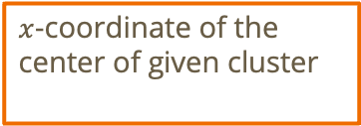
$$z={\left(x−\overline{x}\right)}^{2}+{\left(y−\overline{y}\right)}^{2}$$
What does this transformation do?
On a 1-dimensional axis, it groups points with a similar radius.
Hence, we will see that the visible clusters from our original image will be preserved on 1D!
We are transforming onto a 1D space!
$x$-coordinate of the center of given cluster

Slide 63
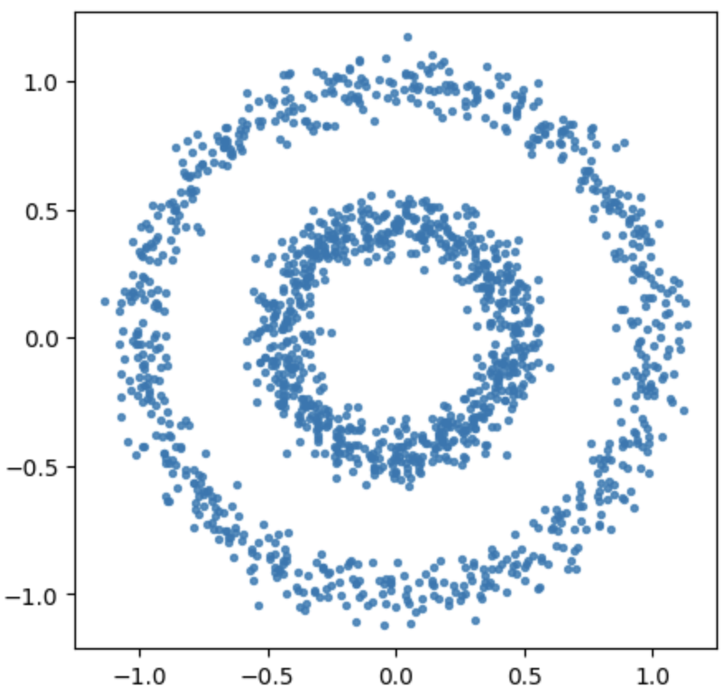
Example

Slide 64
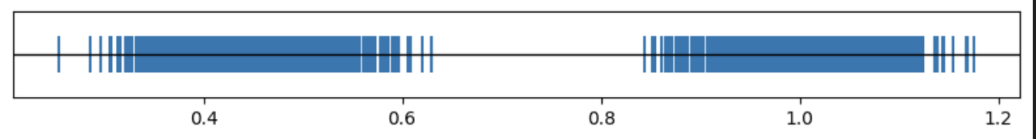
Visualizing the transformation

Slide 65
Expanding our data science toolkit!
The way we originally interpret data may not be ideal for whatever technique we intend to use.

Slide 66
Expanding our data science toolkit!
The way we originally interpret data may not be ideal for whatever technique we intend to use.
If we’re careful, we can transform our data to a space that is more compatible with our technique!

Slide 67
Expanding our data science toolkit!
The way we originally interpret data may not be ideal for whatever technique we intend to use.
If we’re careful, we can transform our data to a space that is more compatible with our technique!
In this process, we must be careful that:

Slide 68
Expanding our data science toolkit!
The way we originally interpret data may not be ideal for whatever technique we intend to use.
If we’re careful, we can transform our data to a space that is more compatible with our technique!
In this process, we must be careful that:
We’re not losing important structure in our data

Slide 69
Expanding our data science toolkit!
The way we originally interpret data may not be ideal for whatever technique we intend to use.
If we’re careful, we can transform our data to a space that is more compatible with our technique!
In this process, we must be careful that:
We’re not losing important structure in our data
The forced assumptions of the transformation aligns with the original data

Slide 70
Expanding our data science toolkit!
The way we originally interpret data may not be ideal for whatever technique we intend to use.
If we’re careful, we can transform our data to a space that is more compatible with our technique!
In this process, we must be careful that:
We’re not losing important structure in our data
The forced assumptions of the transformation aligns with the original data
We’re not giving in to confirmation bias (transforming the data to encode our expectations)

Slide 71
Do not edit How to change the design
How many clusters would be created by cutting the dendrogram as below?
The Slido app must be installed on every computer you’re presenting from

Slide 72
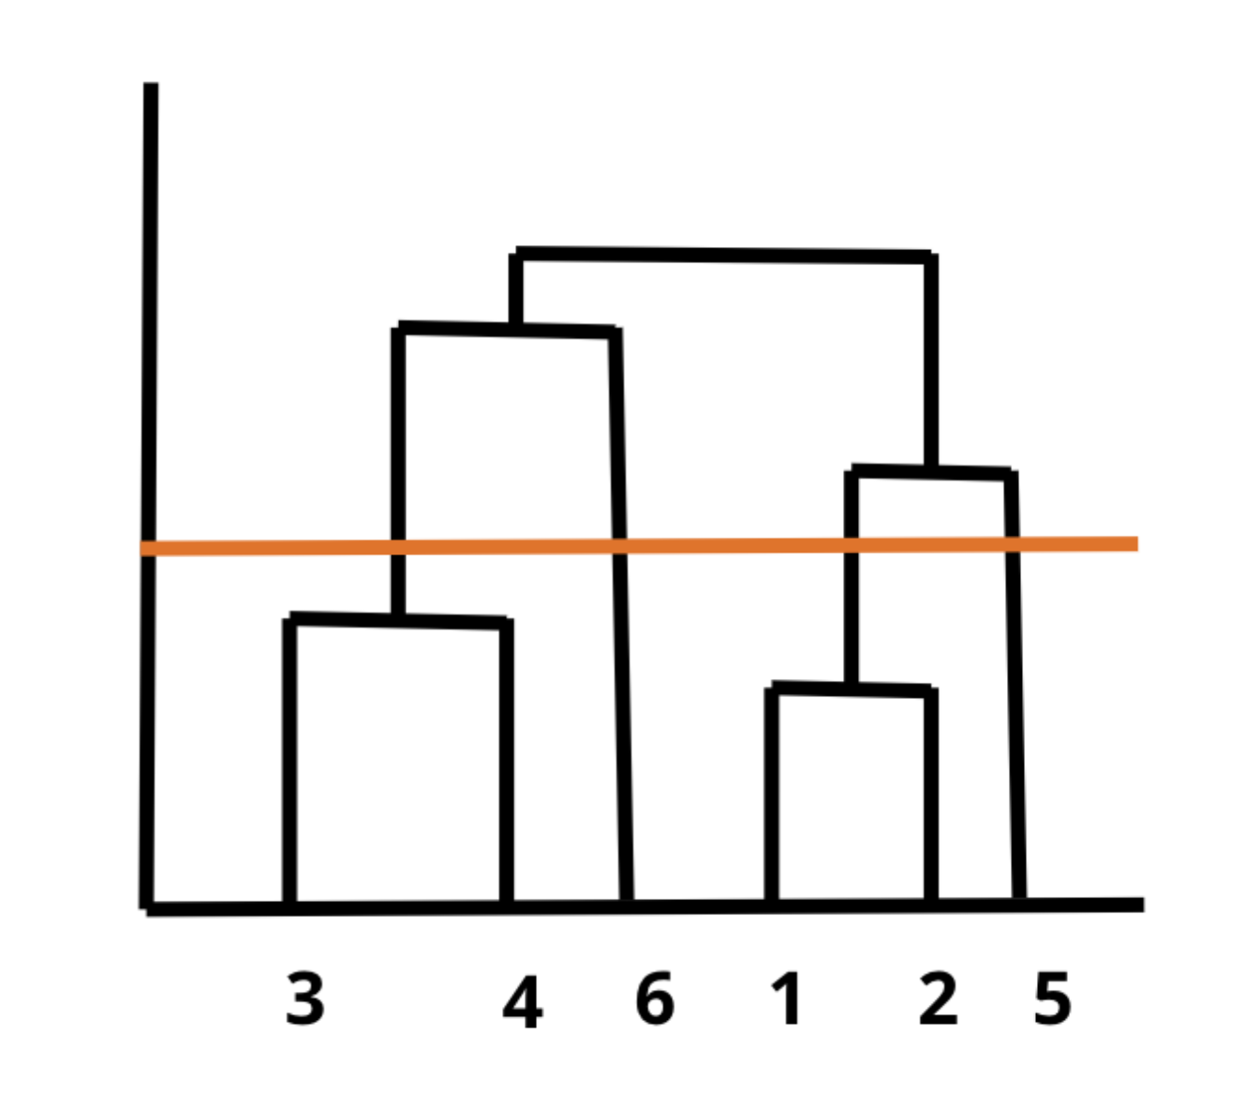
Notes:
NOTE Y-AXIS IS CLUSTER DISTANCE, X-AXIS represents each data point

Slide 77
Recall: link functions
Purpose: to find the distance between a point and a cluster or two clusters

Slide 78

Recall: link functions
Single-link distance: $D_{SL}\left(C_{1}, C_{2}\right)$ = $\min{\{d\left(p_{1},p_{2}\right)|p_{1}∈C_{1},p_{2}∈C_{2}}\}$

Slide 79

Recall: link functions
Single-link distance: $D_{SL}\left(C_{1}, C_{2}\right)$ = $\min{\{d\left(p_{1},p_{2}\right)|p_{1}∈C_{1},p_{2}∈C_{2}}\}$
Complete-link distance: $D_{CL}\left(C_{1},C_{2}\right)=\max{\{d\left(p_{1},p_{2}\right)|p_{1}∈C_{1},p_{2}∈C_{2}\}}$

Slide 80
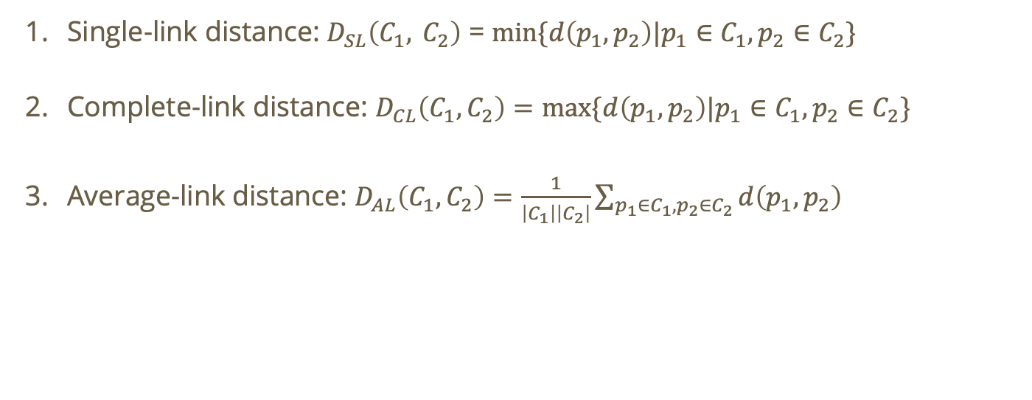
Recall: link functions
Single-link distance: $D_{SL}\left(C_{1}, C_{2}\right)$ = $\min{\{d\left(p_{1},p_{2}\right)|p_{1}∈C_{1},p_{2}∈C_{2}}\}$
Complete-link distance: $D_{CL}\left(C_{1},C_{2}\right)=\max{\{d\left(p_{1},p_{2}\right)|p_{1}∈C_{1},p_{2}∈C_{2}\}}$
Average-link distance: $D_{AL}\left(C_{1},C_{2}\right)=\frac{1}{\left|C_{1}\right|\left|C_{2}\right|}\sum_{p_{1}∈C_{1},p_{2}∈C_{2}}{d\left(p_{1},p_{2}\right)}$

Slide 81
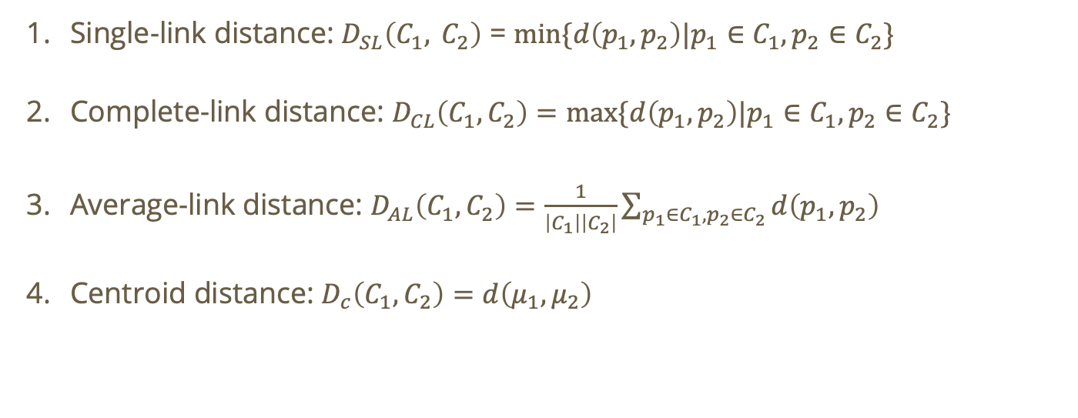
Recall: link functions
Single-link distance: $D_{SL}\left(C_{1}, C_{2}\right)$ = $\min{\{d\left(p_{1},p_{2}\right)|p_{1}∈C_{1},p_{2}∈C_{2}}\}$
Complete-link distance: $D_{CL}\left(C_{1},C_{2}\right)=\max{\{d\left(p_{1},p_{2}\right)|p_{1}∈C_{1},p_{2}∈C_{2}\}}$
Average-link distance: $D_{AL}\left(C_{1},C_{2}\right)=\frac{1}{\left|C_{1}\right|\left|C_{2}\right|}\sum_{p_{1}∈C_{1},p_{2}∈C_{2}}{d\left(p_{1},p_{2}\right)}$
Centroid distance: $D_{c}\left(C_{1},C_{2}\right)=d\left(μ_{1},μ_{2}\right)$

Slide 82
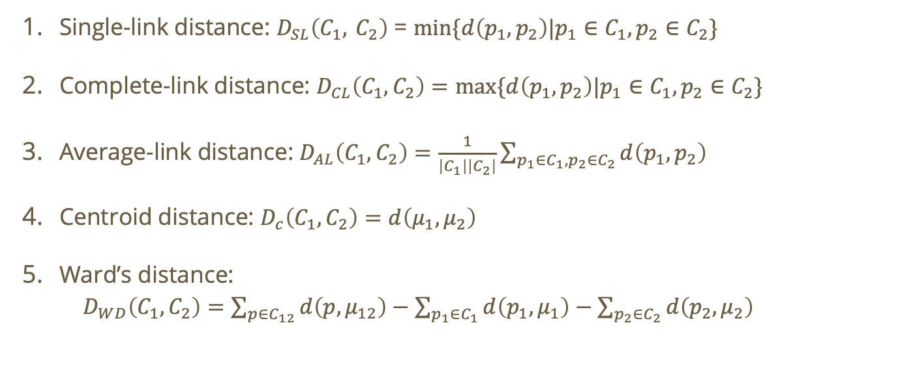
Recall: link functions
Single-link distance: $D_{SL}\left(C_{1}, C_{2}\right)$ = $\min{\{d\left(p_{1},p_{2}\right)|p_{1}∈C_{1},p_{2}∈C_{2}}\}$
Complete-link distance: $D_{CL}\left(C_{1},C_{2}\right)=\max{\{d\left(p_{1},p_{2}\right)|p_{1}∈C_{1},p_{2}∈C_{2}\}}$
Average-link distance: $D_{AL}\left(C_{1},C_{2}\right)=\frac{1}{\left|C_{1}\right|\left|C_{2}\right|}\sum_{p_{1}∈C_{1},p_{2}∈C_{2}}{d\left(p_{1},p_{2}\right)}$
Centroid distance: $D_{c}\left(C_{1},C_{2}\right)=d\left(μ_{1},μ_{2}\right)$
Ward’s distance:
$D_{WD}\left(C_{1},C_{2}\right)=\sum_{p∈C_{12}}{d\left(p,μ_{12}\right)}−\sum_{p_{1}∈C_{1}}{d\left(p_{1},μ_{1}\right)}−\sum_{p_{2}∈C_{2}}{d\left(p_{2},μ_{2}\right)}$

Slide 83




Example
What would merge next under single-link distance?
$$B\left(0,3\right)$$
$$A\left(1,2\right)$$
$$C\left(−1,0\right)$$
$$D\left(3,0\right)$$

Slide 84



Example
What would merge next under single-link distance?
$$B\left(0,3\right)$$
$$A\left(1,2\right)$$
$$\sqrt{10}$$
$$\sqrt{8}$$
$$C\left(−1,0\right)$$
$$D\left(3,0\right)$$

Slide 85

Example
What would merge next under single-link distance?
$$B\left(0,3\right)$$
$$D_{SL}\left(C,AB\right)=\min{\{\sqrt{10}},\sqrt{8}\}=\sqrt{8}$$
$$A\left(1,2\right)$$
$$\sqrt{10}$$
$$\sqrt{8}$$
$$C\left(−1,0\right)$$
$$D\left(3,0\right)$$

Slide 86


Example
What would merge next under single-link distance?
$$B\left(0,3\right)$$
$$D_{SL}\left(C,AB\right)=\min{\{\sqrt{10}},\sqrt{8}\}=\sqrt{8}$$
$$\sqrt{18}$$
$$A\left(1,2\right)$$
$$\sqrt{8}$$
$$C\left(−1,0\right)$$
$$D\left(3,0\right)$$

Slide 87

Example
What would merge next under single-link distance?
$$B\left(0,3\right)$$
$$D_{SL}\left(C,AB\right)=\min{\{\sqrt{10}},\sqrt{8}\}=\sqrt{8}$$
$$D_{SL}\left(D,AB\right)=\min{\{\sqrt{8}},\sqrt{18}\}=\sqrt{8}$$
$$\sqrt{18}$$
$$A\left(1,2\right)$$
$$\sqrt{8}$$
$$C\left(−1,0\right)$$
$$D\left(3,0\right)$$

Slide 88
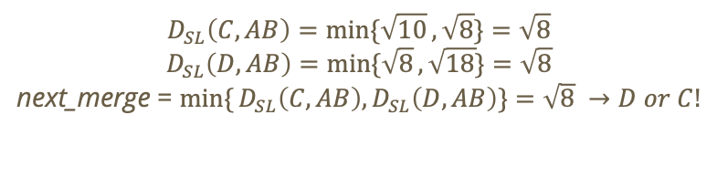
Example
What would merge next under single-link distance?
$$B\left(0,3\right)$$
$$D_{SL}\left(C,AB\right)=\min{\{\sqrt{10}},\sqrt{8}\}=\sqrt{8}$$
$$D_{SL}\left(D,AB\right)=\min{\{\sqrt{8}},\sqrt{18}\}=\sqrt{8}$$
next_merge = $\min{\{}D_{SL}\left(C,AB\right),D_{SL}\left(D,AB\right)\}=\sqrt{8} →D or C!$
$$A\left(1,2\right)$$
$$C\left(−1,0\right)$$
$$D\left(3,0\right)$$

Slide 89
Example
What would merge next under complete-link distance?
$$B\left(0,3\right)$$
$$A\left(1,2\right)$$
$$C\left(−1,0\right)$$
$$D\left(3,0\right)$$

Slide 90

Example
What would merge next under complete-link distance?
$$B\left(0,3\right)$$
$$D_{CL}\left(C,AB\right)=\max{\{\sqrt{10}},\sqrt{8}\}=\sqrt{10}$$
$$A\left(1,2\right)$$
$$\sqrt{10}$$
$$\sqrt{8}$$
$$C\left(−1,0\right)$$
$$D\left(3,0\right)$$

Slide 91
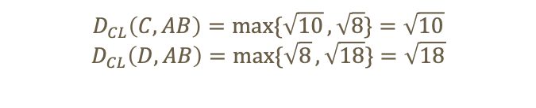
Example
What would merge next under complete-link distance?
$$B\left(0,3\right)$$
$$D_{CL}\left(C,AB\right)=\max{\{\sqrt{10}},\sqrt{8}\}=\sqrt{10}$$
$$D_{CL}\left(D,AB\right)=\max{\{\sqrt{8}},\sqrt{18}\}=\sqrt{18}$$
$$\sqrt{18}$$
$$A\left(1,2\right)$$
$$\sqrt{8}$$
$$C\left(−1,0\right)$$
$$D\left(3,0\right)$$

Slide 92
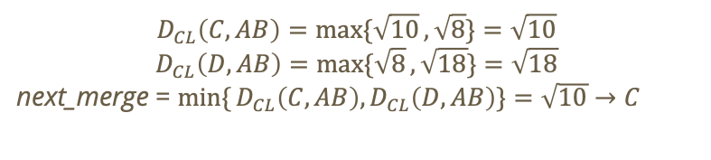
Example
What would merge next under complete-link distance?
$$B\left(0,3\right)$$
$$D_{CL}\left(C,AB\right)=\max{\{\sqrt{10}},\sqrt{8}\}=\sqrt{10}$$
$$D_{CL}\left(D,AB\right)=\max{\{\sqrt{8}},\sqrt{18}\}=\sqrt{18}$$
next_merge = $\min{\{}D_{CL}\left(C,AB\right),D_{CL}\left(D,AB\right)\}=\sqrt{10}→C$
$$A\left(1,2\right)$$
$$C\left(−1,0\right)$$
$$D\left(3,0\right)$$

Slide 93
Example
What would merge next under complete-link distance?
$$B\left(0,3\right)$$
$$D_{CL}\left(C,AB\right)=\max{\{\sqrt{10}},\sqrt{8}\}=\sqrt{10}$$
$$D_{CL}\left(D,AB\right)=\max{\{\sqrt{8}},\sqrt{18}\}=\sqrt{18}$$
next_merge = $\min{\{}D_{CL}\left(C,AB\right),D_{CL}\left(D,AB\right)\}=\sqrt{10}→C$
$$A\left(1,2\right)$$
$$C\left(−1,0\right)$$
$$D\left(3,0\right)$$
This line is the same for all link functions!!

Slide 94
Do not edit How to change the design
Which link function(s) would make Hierarchical clustering well suited for the following dataset?
The Slido app must be installed on every computer you’re presenting from

Slide 95
Do not edit How to change the design
Which clusters get merged if using Euclidean and complete-link distance?
The Slido app must be installed on every computer you’re presenting from

Slide 96
Do not edit How to change the design
Using Euclidean and complete-link distance for {A = (1,2), B = (3,5), C = (4,1), D = (7,3), E = (6,6)} what is the merging order?
The Slido app must be installed on every computer you’re presenting from

Slide 97
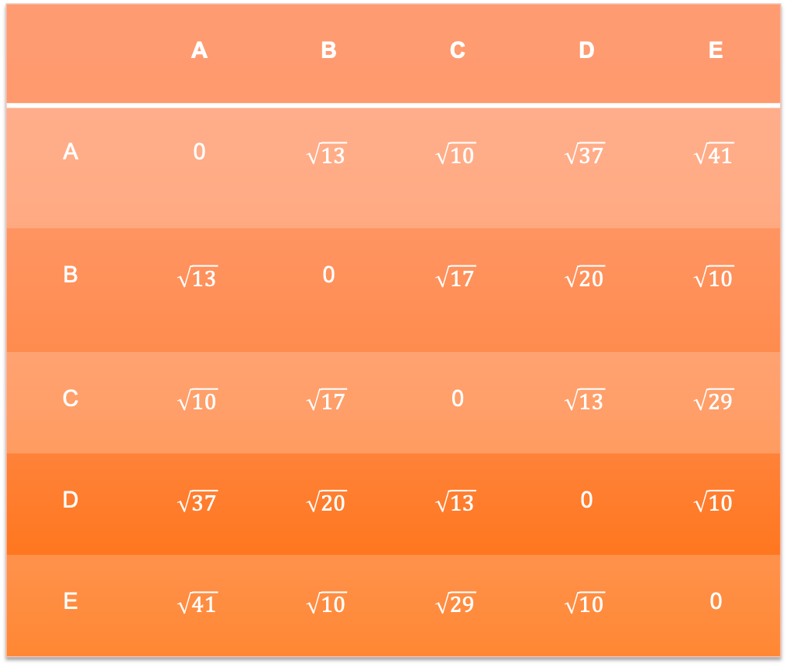
 | A | B | C | D | E
A | 0 | $$\sqrt{13}$$ | $$\sqrt{10}$$ | $$\sqrt{37}$$ | $$\sqrt{41}$$
B | $$\sqrt{13}$$ | 0 | $$\sqrt{17}$$ | $$\sqrt{20}$$ | $$\sqrt{10}$$
C | $$\sqrt{10}$$ | $$\sqrt{17}$$ | 0 | $$\sqrt{13}$$ | $$\sqrt{29}$$
D | $$\sqrt{37}$$ | $$\sqrt{20}$$ | $$\sqrt{13}$$ | 0 | $$\sqrt{10}$$
E | $$\sqrt{41}$$ | $$\sqrt{10}$$ | $$\sqrt{29}$$ | $$\sqrt{10}$$ | 0
Notes:
Insert equation: ctrl + option + =

Slide 98
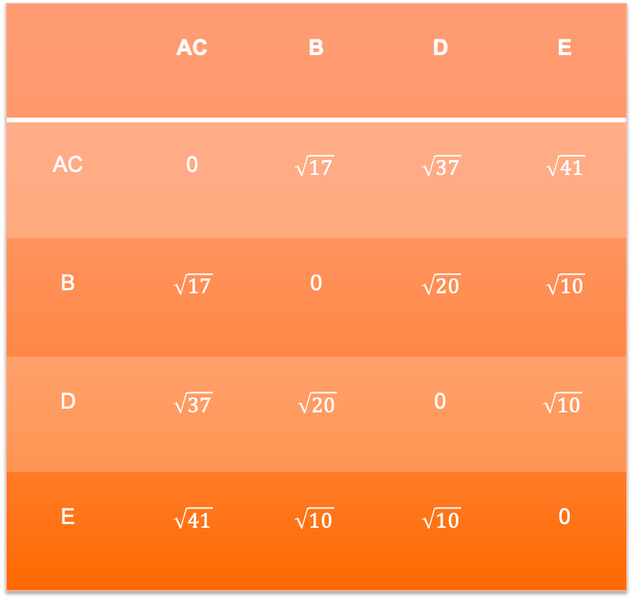
 | AC | B | D | E
AC | 0 | $$\sqrt{17}$$ | $$\sqrt{37}$$ | $$\sqrt{41}$$
B | $$\sqrt{17}$$ | 0 | $$\sqrt{20}$$ | $$\sqrt{10}$$
D | $$\sqrt{37}$$ | $$\sqrt{20}$$ | 0 | $$\sqrt{10}$$
E | $$\sqrt{41}$$ | $$\sqrt{10}$$ | $$\sqrt{10}$$ | 0
Notes:
Insert equation: ctrl + option + =

Slide 99
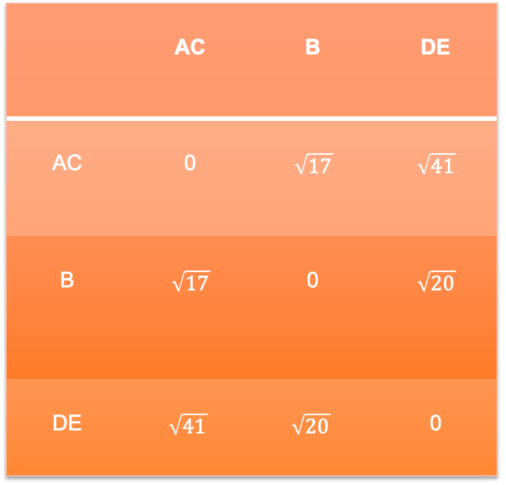
 | AC | B | DE
AC | 0 | $$\sqrt{17}$$ | $$\sqrt{41}$$
B | $$\sqrt{17}$$ | 0 | $$\sqrt{20}$$
DE | $$\sqrt{41}$$ | $$\sqrt{20}$$ | 0
Notes:
Insert equation: ctrl + option + =

Slide 100
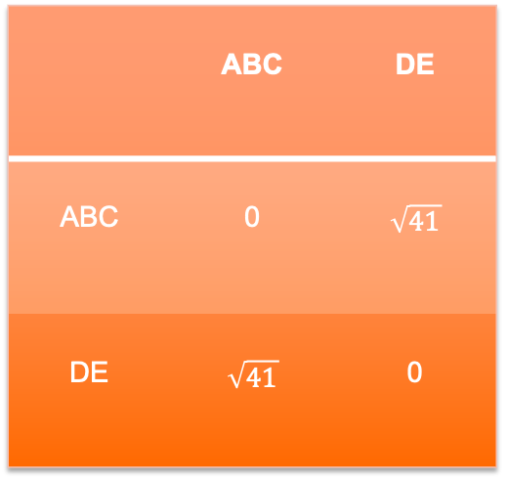
 | ABC | DE
ABC | 0 | $$\sqrt{41}$$
DE | $$\sqrt{41}$$ | 0
Notes:
Insert equation: ctrl + option + =

Slide 101
fin

